Slide 1

Department of Collegiate and Technical Education
Artificial Intelligence and Machine Learning
( V Semester)
WEEK-6 Session-6
Perform Data Preprocessing, Exploration and Splitting on Dataset
Course Code: 20CS51I
Computer Science and Engineering

Slide 2
What we learned in previous session?
Cross Validation
Need of Cross Validation
Techniques
Hold – out method
Leave One Out Cross Validation
K- Fold Cross Validation
Computer Science & Engineering –20CS51I

Slide 3
Table of Contents – Session 6
Introduction of Crop Production dataset
Import the Required Libraries
Import Dataset and Understand It
Data Pre-processing
Exploratory Data Analysis
Preparing the Data for Training the Model
Splitting the Data into Training and Testing sets
Conclusion
Computer Science & Engineering –20CS51I

Slide 4
Introduction of Crop Production dataset
The Crop Production Dataset contains different crops and their production of different districts of India from the year 1997– 2014.
Access this dataset from the Data World / Kaggle website.
The main objective of Crop Production dataset is to predict the crop production data for different years
Computer Science & Engineering –20CS51I

Slide 5
Import the Required Libraries
import numpy as np
import matplotlib.pyplot as plt
import pandas as pd
import seaborn as sns
%matplotlib inline
Computer Science & Engineering –20CS51I

Slide 6
Import Dataset and Understand It
Load the dataset
data = pd.read_csv('crop_production.csv')
To display top 5 values of crop_production.csv dataset
data.head()
Computer Science & Engineering –20CS51I

Slide 7
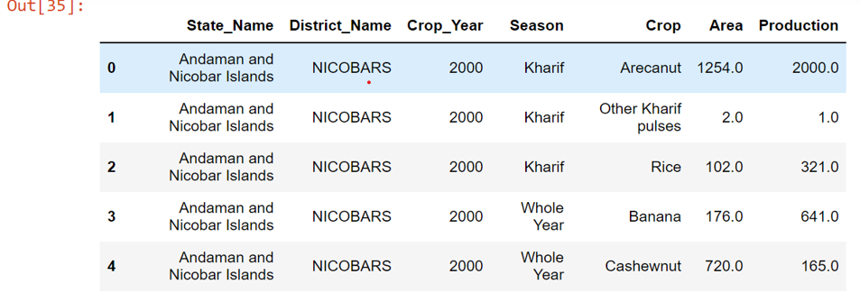
Import Dataset and Understand It
#output
Computer Science & Engineering –20CS51I

Slide 8
Import Dataset and Understand It
To display Data description of crop_production.csv dataset
data.info()
Computer Science & Engineering –20CS51I

Slide 9
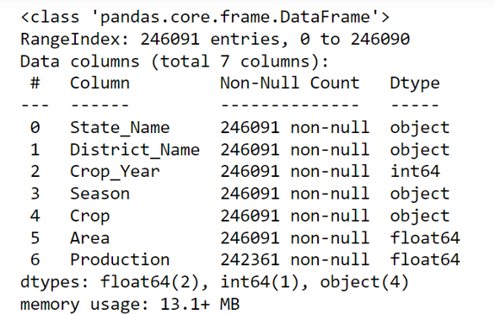
Import Dataset and Understand It
#output
Computer Science & Engineering –20CS51I

Slide 10

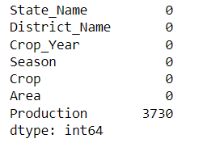
Data Pre-processing
After loading the data, it’s a good practice to see if there are any missing values in the data. We count the number of missing values for each feature using isnull()
boston.isnull().sum()
There are some missing values in this dataset as shown below
Computer Science & Engineering –20CS51I

Slide 11
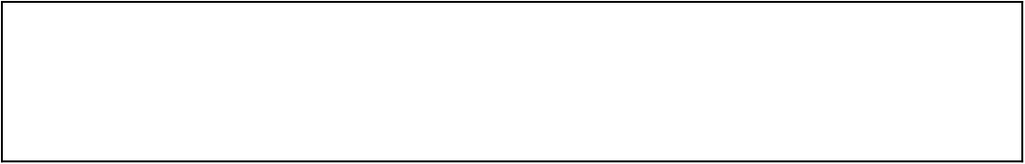
Data Pre-processing
To remove missing values in dataset
data = data.dropna(how='any',axis=0)
Again we count the number of missing values for each feature using isnull()
data.isnull().sum()
Computer Science & Engineering –20CS51I

Slide 12
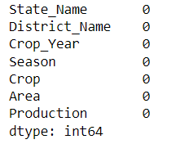
Data Pre-processing
Now there are no missing values in the dataset as shown below
Computer Science & Engineering –20CS51I

Slide 13
Exploratory Data Analysis
Let’s first plot the distribution of the target variable Crop_Year. We will use the displot function from the seaborn library.
sns.set(rc={'figure.figsize':(11.7,8.27)})
sns.displot(data['Crop_Year'], bins=30)
plt.show()
Computer Science & Engineering –20CS51I

Slide 14
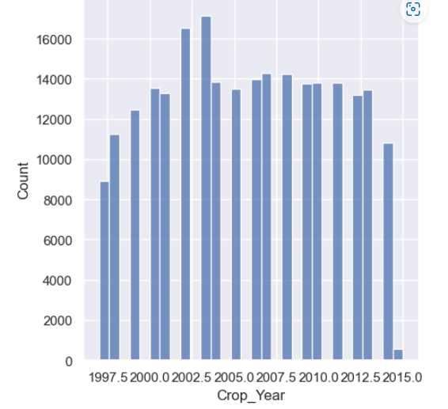
Exploratory Data Analysis
# output
Computer Science & Engineering –20CS51I

Slide 15

Exploratory Data Analysis
Using a scatter plot let’s see how Production and Area features vary with Crop_Year.
plt.figure(figsize=(20, 5))
features = ['Production', 'Area']
target = data['Crop_Year']
for i, col in enumerate(features):
plt.subplot(1, len(features) , i+1)
x = data[col]
y = target
plt.scatter(x, y, marker='o')
plt.title(col)
plt.xlabel(col)
plt.ylabel('Crop_Year')
Computer Science & Engineering –20CS51I

Slide 16
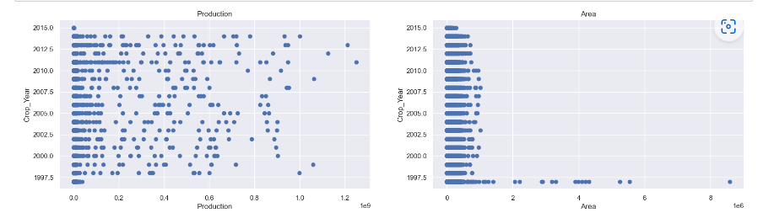
Exploratory Data Analysis
#output
Computer Science & Engineering –20CS51I

Slide 17
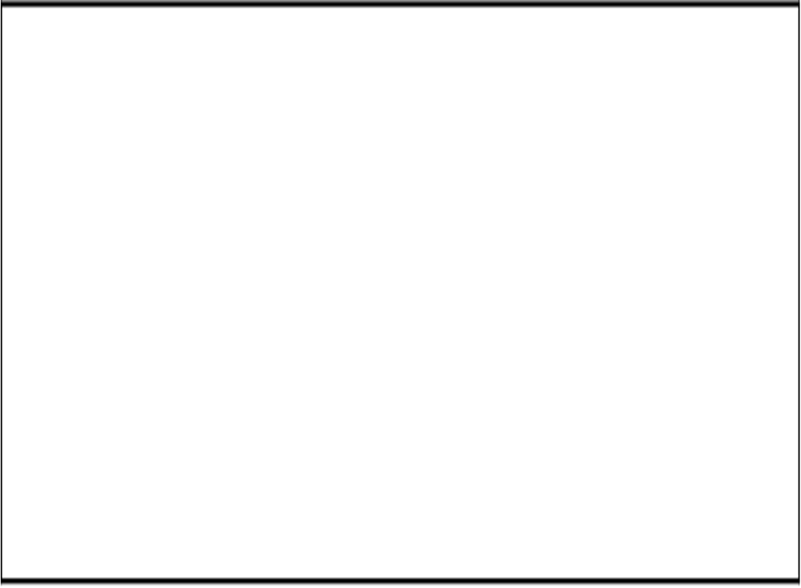
Preparing the Data for Training the Model
Concatenate the Production and Area columns using np.c_ provided by the numpy library.
X = pd.DataFrame(np.c_[data['Production'], data['Area']], columns = ['Production','Area'])
Y = data['Crop_Year']
Computer Science & Engineering –20CS51I

Slide 18
Splitting the Data into Training and Testing Sets
To split the data, we use train_test_split function provided by scikit-learn library. We finally print the sizes of our training and test set to verify if the splitting has occurred properly.
from sklearn.linear_model import LinearRegression
from sklearn.model_selection import train_test_split
# get the locations
X = data.iloc[:, :-1]
y = data.iloc[:, -1]
Computer Science & Engineering –20CS51I

Slide 19

Splitting the Data into Training and Testing Sets
# split the dataset
X_train, X_test, y_train, y_test = train_test_split(X, y, test_size=0.05, random_state=0)
print(X_train.shape)
print(X_test.shape)
print(y_train.shape)
print(y_test.shape)
Computer Science & Engineering –20CS51I

Slide 20
Splitting the Data into Training and Testing Sets
#output
Computer Science & Engineering –20CS51I

Slide 21
Conclusion
Now Data is ready to be fed to a Machine Learning Algorithm.
Computer Science & Engineering –20CS51I

Slide 22

Thank You
Content Developers
BHAVANI H R | 119 Government Polytechnic for Women, Bangalore

